Slide 1
CSE 3400 - Introduction to Computer & Network Security (aka: Introduction to Cybersecurity) Lecture 11 Public Key Cryptography– Part II
Ghada Almashaqbeh
UConn
From Textbook Slides by Prof. Amir Herzberg
UConn

Slide 2
Outline
Public key encryption.
Digital signatures.
2

Slide 3
Public Key Encryption
3

Slide 4
Public Key Encryption
Key length l
KeyGen KG
Encryption Key e
(public)
(e,d)
Decryption Key d
(private)
e
d
Plaintext
m
Encrypt E
Ciphertext c=E_{e}(m)
Decrypt D
Plaintext m=D_{d}(E_{e}(m))
4

Slide 5
Public Key Encryption IND-CPA Security
5

Slide 6
Discrete Log-based Encryption
We will explore two flavors:
An adaptation of DH key exchange protocol to perform encryption.
ElGamal encryption scheme.

Slide 7

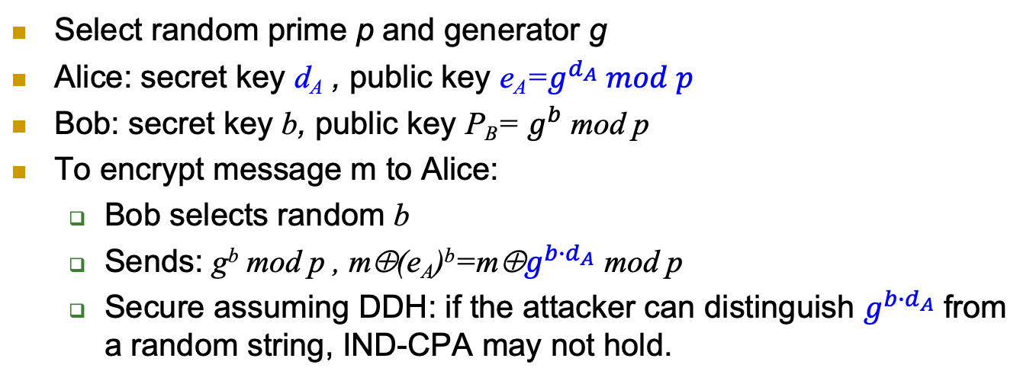


Turning [DH] to Public Key Cryptosystem
Select random prime p and generator g
Alice: secret key d_{A} , public key e_{A}=$g^{d_{A}} mod p$
Bob: secret key b, public key P_{B}= $g^{b}$ mod p
To encrypt message m to Alice:
Bob selects random b
Sends: g^{b} mod p , m⊕(e_{A})^{b}=m⊕$g^{{b∙d}_{A}}$ mod p
Secure assuming DDH: if the attacker can distinguish $g^{{b∙d}_{A}}$ from a random string, IND-CPA may not hold.

Slide 8


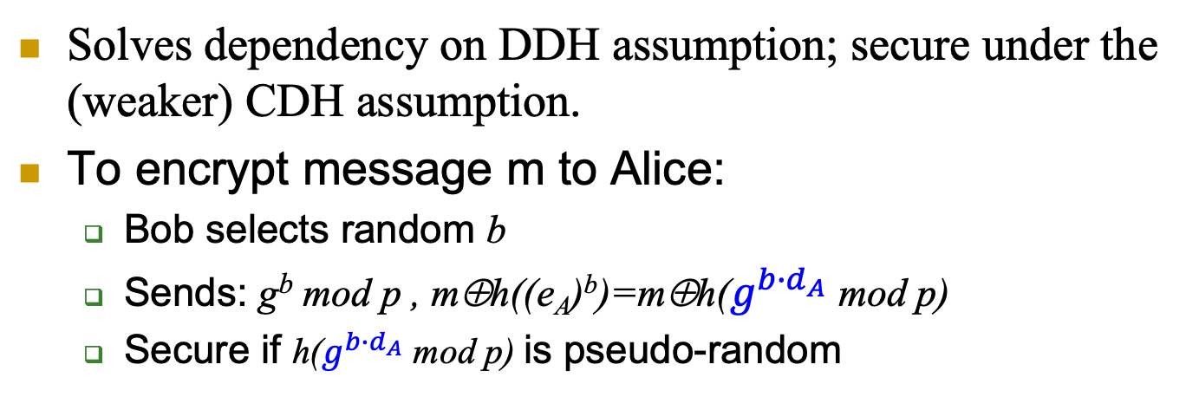
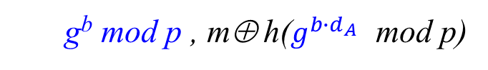
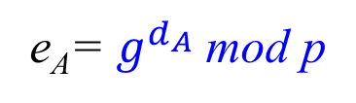
Turning [DH] to Public Key Cryptosystem
Solves dependency on DDH assumption; secure under the (weaker) CDH assumption.
To encrypt message m to Alice:
Bob selects random b
Sends: g^{b} mod p , m⊕h((e_{A})^{b})=m⊕h($g^{{b∙d}_{A}}$ mod p)
Secure if h($g^{{b∙d}_{A}}$ mod p) is pseudo-random
Alice
e_{A}= $g^{d_{A}}$ mod p
Bob
g^{b} mod p , m⊕ h($g^{{b∙d}_{A}}$ mod p)

Slide 9
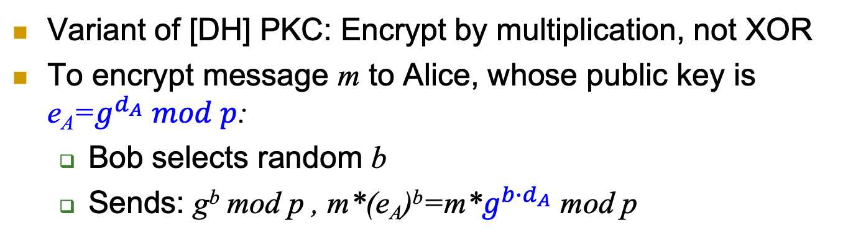
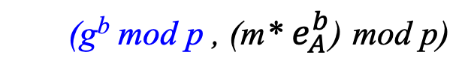
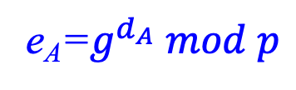
ElGamal Public Key Encyption
Variant of [DH] PKC: Encrypt by multiplication, not XOR
To encrypt message m to Alice, whose public key is e_{A}=$g^{d_{A}} mod p$:
Bob selects random b
Sends: g^{b} mod p , m*(e_{A})^{b}=m*$g^{{b∙d}_{A}}$ mod p
Alice
e_{A}=$g^{d_{A}} mod p$
Bob
Select
random b
(g^{b} mod p , (m* $e_{A}^{b}$) mod p)

Slide 10
ElGamal Public Key Encryption
Encryption:
Decryption:
Correctness:

Slide 11
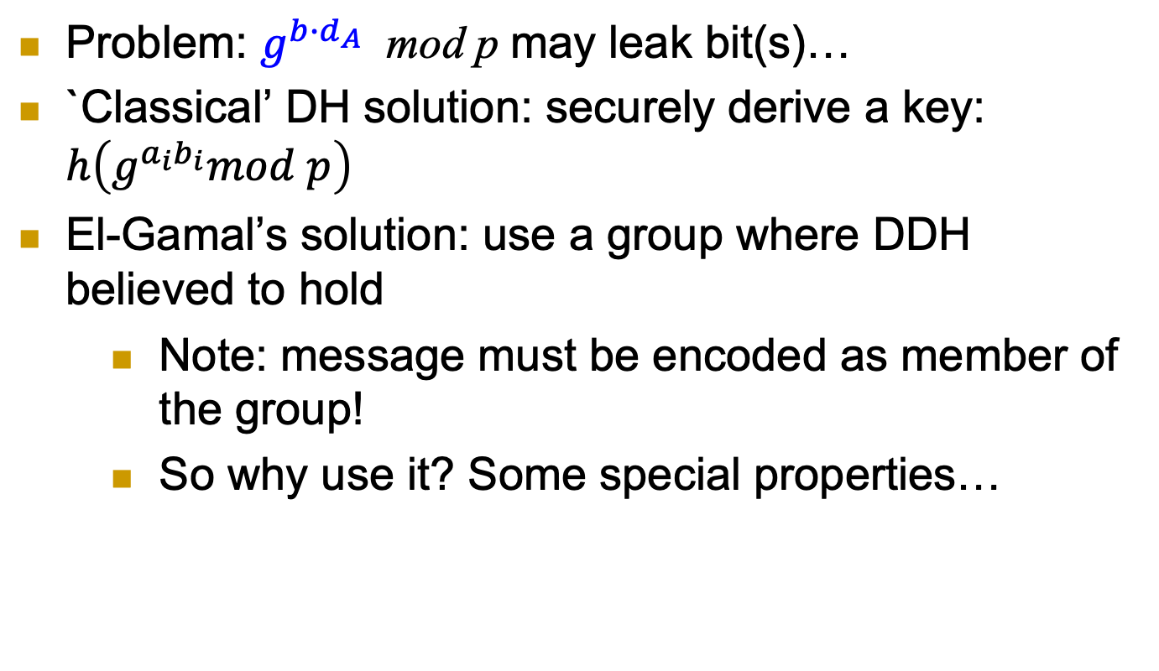
ElGamal Public Key Cryptosystem
Problem: $g^{{b∙d}_{A}}$ mod p may leak bit(s)…
`Classical’ DH solution: securely derive a key: $h\left(g^{a_{i}b_{i}}mod p\right)$
El-Gamal’s solution: use a group where DDH believed to hold
Note: message must be encoded as member of the group!
So why use it? Some special properties…

Slide 12
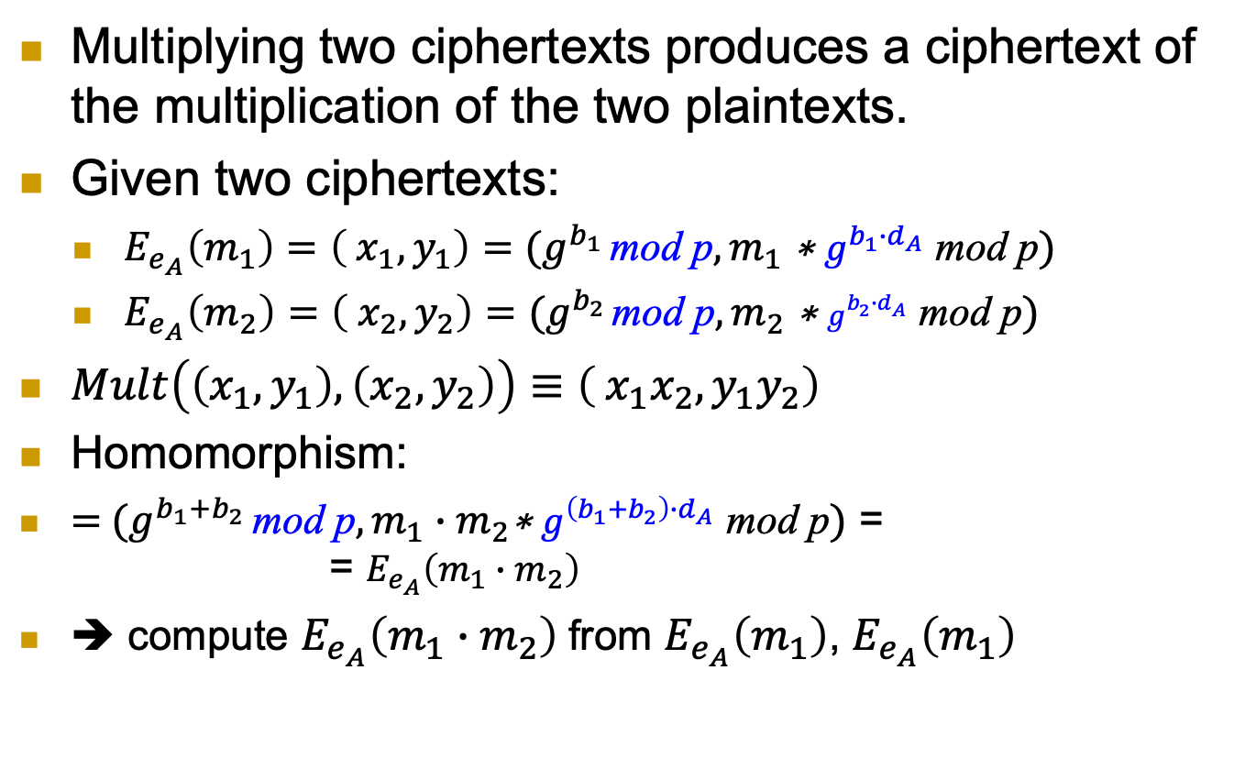
ElGamal PKC: homomorphism
Multiplying two ciphertexts produces a ciphertext of the multiplication of the two plaintexts.
Given two ciphertexts:
$E_{e_{A}}\left(m_{1}\right)=\left( x_{1},y_{1}\right)=(g^{b_{1}} \text{mod} \text{p},m_{1} \text{∗ }g^{{b_{1}∙d}_{A}} \text{mod} \text{p})$
$E_{e_{A}}\left(m_{2}\right)=\left( x_{2},y_{2}\right)$ $=(g^{b_{2}} \text{mod} \text{p},m_{2} \text{∗ }g^{{b_{2}∙d}_{A}} \text{mod} \text{p})$
$Mult\left(\left(x_{1},y_{1}\right),\left(x_{2},y_{2}\right)\right)≡\left( x_{1}x_{2},y_{1}y_{2}\right)$
Homomorphism:
$=$ $(g^{b_{1}+b_{2}} \text{mod} \text{p},m_{1}∙m_{2}\text{∗ }g^{{\left(b_{1}+b_{2}\right)∙d}_{A}} \text{mod} \text{p})$ = = $E_{e_{A}}\left(m_{1}∙m_{2}\right)$
➔ compute $E_{e_{A}}\left(m_{1}∙m_{2}\right)$from $E_{e_{A}}\left(m_{1}\right)$, $E_{e_{A}}\left(m_{1}\right)$

Slide 13
RSA Public Key Encryption
2002 Turing
Award
First proposed – and still widely used
Not really covered in this course – take crypto!
Select two large primes p,q ; let n=pq
Select prime e (public key: <n,e>)
Or co-prime with Φ(n) =(p-1)(q-1)
Let private key be d=e⁻¹ mod Φ(n) (i.e., ed=1 mod Φ(n))
Encryption: RSA.E_{e,n}(m)=m^{e} mod n
Decryption: RSA.D_{d,n}(c)=c^{d} mod n
Correctness: D_{d,n}(E_{e,n}(m))= (m^{e})^{d} = m^{ed} = m mod n
Intuitively: ed=1 mod Φ(n) ➔ m^{ed} = m mod n
But why? Remember Euler’s theorem.

Slide 14
RSA Public Key Cryptosystem
Correctness: D_{d,n}(E_{e,n}(m))= m^{ed} mod n
m^{ed}=m^{ed}= m^{1+l Φ(n)} =m m^{l Φ(n)} =m (m^{Φ(n)} )^{l}
m^{ed} mod n =m (m^{Φ(n)} mod n )^{l} mod n
Eulers’Theorem: m^{Φ(n)} mod n=1 mod n
➔ D_{d,n}(E_{e,n}(m))= m^{ed} mod n=m 1^{l} mod n =m
Comments:
m<n ➔ m= m mod n
Eulers’ Theorem holds (only) if m, n are co-primes
If not co-primes? Use Chinese Reminder Theorem
A nice, not very complex argument
But: beyond our scope – take Crypto!

Slide 15
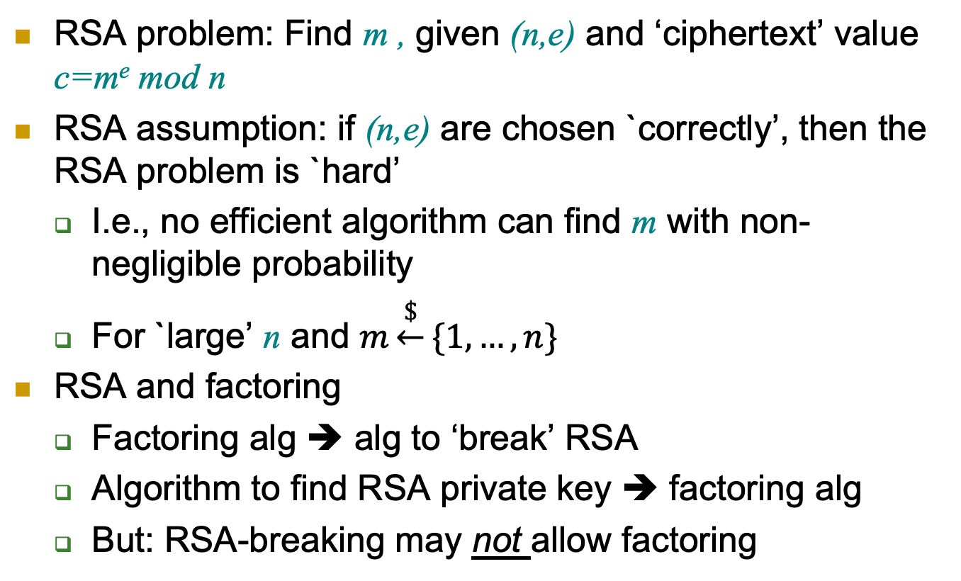
The RSA Problem and Assumption
RSA problem: Find m , given (n,e) and ‘ciphertext’ value c=m^{e} mod n
RSA assumption: if (n,e) are chosen `correctly’, then the RSA problem is `hard’
I.e., no efficient algorithm can find m with non-negligible probability
For `large’ n and $m\underset{←}{\$}\{1,…,n\}$
RSA and factoring
Factoring alg ➔ alg to ‘break’ RSA
Algorithm to find RSA private key ➔ factoring alg
But: RSA-breaking may not allow factoring

Slide 16
RSA PKC Security
It is a deterministic encryption scheme → cannot IND-CPA secure.
RSA assumption does not rule out exposure of partial information about the plaintext.
It is not CCA secure.
A solution: apply a random padding to the plaintext then encryption using RSA.

Slide 17
Padding RSA
Pad and Unpad functions:
Encryption with padding:
Decryption with unpad:
Required to…
Add randomization
Prevent detection of repeating plaintext
Prevent ‘related message’ attack (to allow use of tiny e)
Detect, prevent (some) chosen-ciphertext attacks
Early paddings schemes subject to CCA attacks
Even ‘Feedback-only CCA’ (aware of unpad failure)

Slide 18
How does Bob know Alice’s public key?
Depends on threat model…
Passive (`eavesdropping`) adversary: just send it
Man-in-the-Middle (MITM): authenticate
Authenticate – how?
MAC: requires shared secret key
Public key signature scheme: authenticate using public key
Certificate: public key of entity – signed by certificate authority (CA)

Slide 19
Digital Signature
19

Slide 20
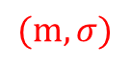
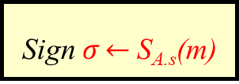
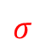
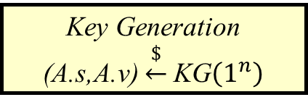
Public Key Digital Signatures
Key Generation
(A.s,A.v) $\underset{←}{\$}$KG$\left(1^{n}\right)$
Key length n
Alice’s private
signing key A.s
Alice’s public verification key A.v
A.s
A.v
Message
m
Sign $σ\underset{←}{}$S_{A.s}(m)
$$σ$$
$$(m,σ)$$
Verify V_{A.v}(m, σ)
Sign using a private, secret signature key (A.s for Alice)
Validate using a public key (A.v for Alice)
Everybody can validate signatures at any time
Provides authentication, integrity and evidence / non-repudiation
MAC: ‘just’ authentication+integrity, no evidence, can repudiate

Slide 21
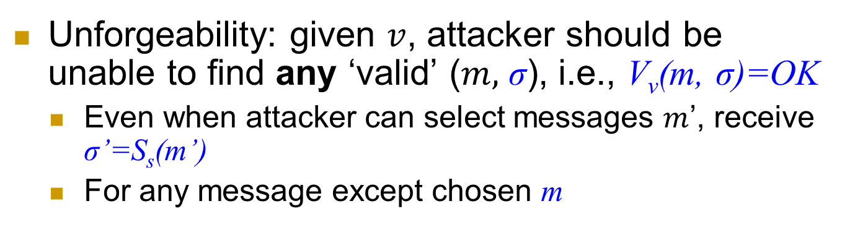
Digital Signatures Security: Unforgeability
Key Generation
(A.s,A.v) $\underset{←}{\$}$KG$\left(1^{n}\right)$
Key length n
Alice’s private
signing key A.s
Alice’s public verification key A.v
A.s
A.v
Message
m
Sign $σ\underset{←}{}$S_{A.s}(m)
$$σ$$
$$(m,σ)$$
Verify V_{A.v}(m, σ)
Unforgeability: given $v$, attacker should be unable to find any ‘valid’ ($m,$ σ), i.e., V_{v}(m, σ)=OK
Even when attacker can select messages $m$’, receive σ’=S_{s}(m’)
For any message except chosen m

Slide 22
Digital Signature Scheme Definition

Slide 23
Digital Signature Scheme Security

Slide 24

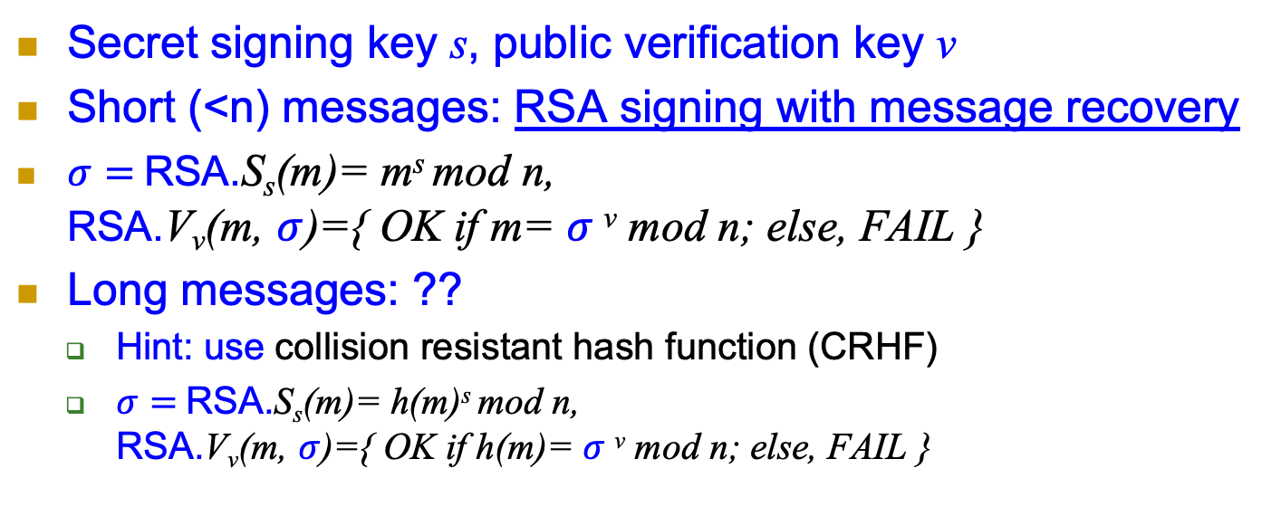
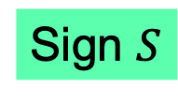
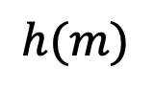
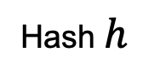

RSA Signatures
Secret signing key s, public verification key v
Short (<n) messages: RSA signing with message recovery
$σ=$RSA.S_{s}(m)= m^{s} mod n, RSA.V_{v}(m, $σ$)={ OK if m= $σ$^{v} mod n; else, FAIL }
Long messages: ??
Hint: use collision resistant hash function (CRHF)
$σ=$RSA.S_{s}(m)= h(m)^{s} mod n, RSA.V_{v}(m, $σ$)={ OK if h(m)= $σ$^{v} mod n; else, FAIL }
Message $m$
Hash $h$
$$h(m)$$
Sign $S$
$$S_{s}^{h}\left(m\right)$$
Notes:
24
(c) Amir Herzberg, http://AmirHerzberg.com, Bar Ilan University
04/07/06

Slide 25
Discrete-Log Digital Signature?
RSA allowed encryption and signing… based on assuming factoring is hard
Can we sign based on assuming discrete log is hard?
Most well-known, popular scheme: DSA
Digital Signature Algorithm, by NSA/NIST
Details: crypto course

Slide 26
Covered Material From the Textbook
Chapter 1, Section: 1.2.3
Chapter 2, Sections 2.7.3
Chapter 6, Sections 6.4, 6.5 (except 6.5.6 and 6.5.7), and 6.6 (except RSA with message recovery)

Slide 27

Thank You!

